Slide 1



AidLink
RIGHT PLACE,RIGHT TIME

Slide 2

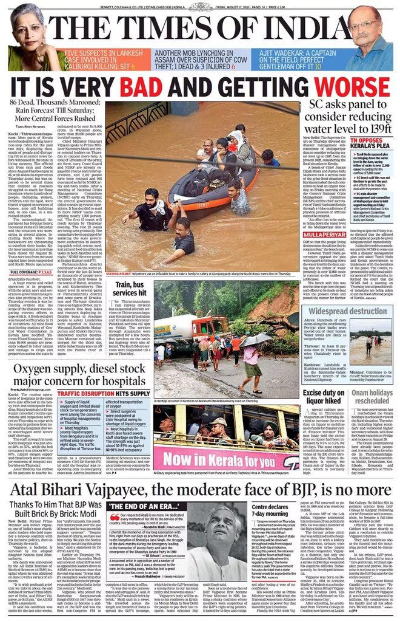
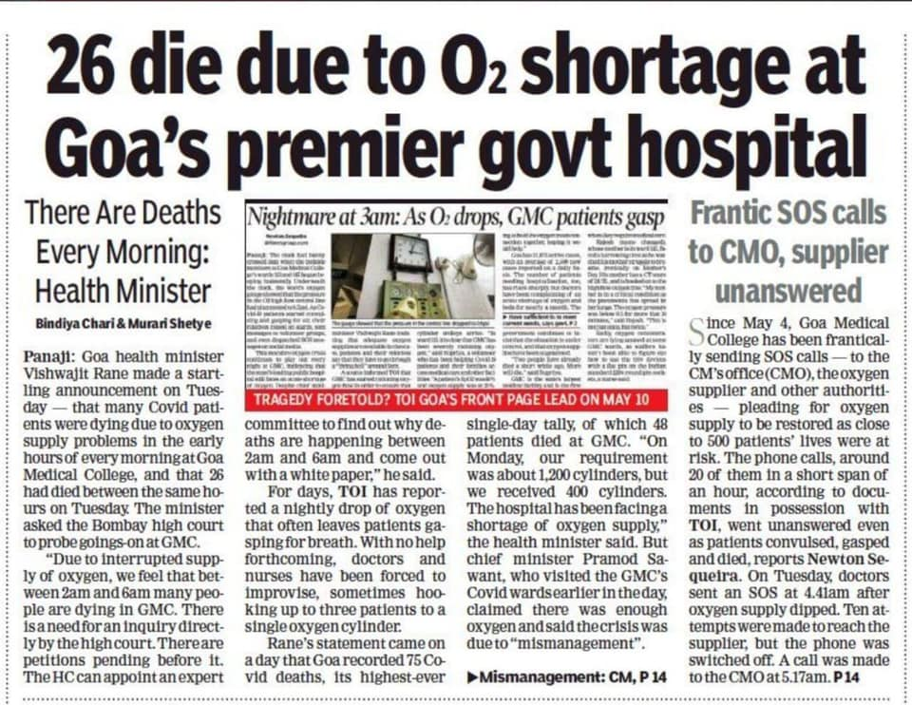
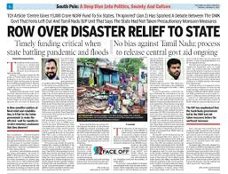
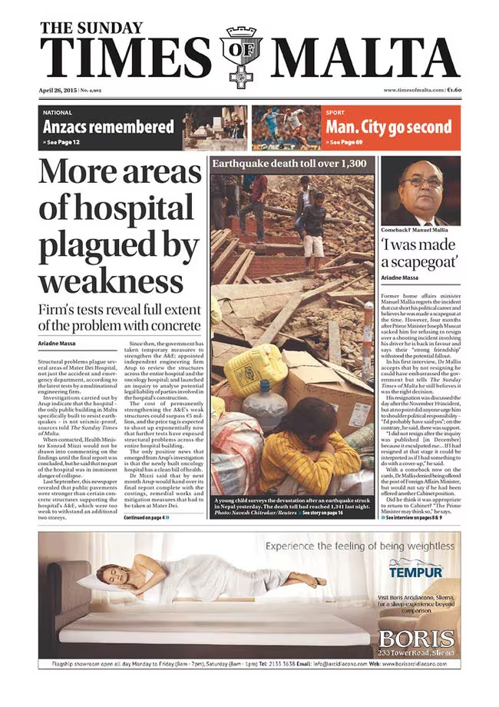
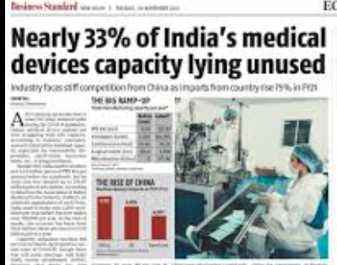
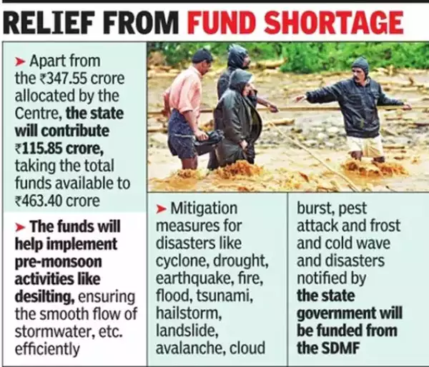

Slide 3

Real-Life Statistics
with examples
Haiti Earthquake (2010)
COVID-19 crisis
Gujarat Earthquake (2001)
$13 billion in aid, yet thousands suffered due to mismanagement
Supply chain failures delayed critical medical supplies
Mismanaged Aid Despite ₹4,500 Crore Relief Fund

Slide 4


DISASTER RELIEF SUPPLY CHAIN MANAGER

Slide 5
Existing System
Shortcomings faced
01
DECENTRALIZED
02
INEFFICIENT
03
LACK OF TRANSPARENCY
No Structured prioritization for relief camps
Relief supply distribution faces delays and inefficiencies
Need for a solution that ensures fair, fast, and effective distribution.

Slide 6
CENTRALIZATION
01
Proposed System
A centralized system optimizing supply allocation and distribution
02
EFFICIENT
Uses priority-based and greedy algorithms for effective relief delivery
TRANSPARENCY
Rapid Aid, Right Place, Right time
03
Real-time tracking ensures transparency and accountability

Slide 7
RESEARCH PAPERS
IEEE published papers used as a reference
01
02
03
The Risk Priority Number Methodology for Distribution Priority of Emergency Logistics after Earthquake Disasters
Vehicle Routing Optimization for Humanitarian Supply Chain: A Systematic Review of Approaches and Solution
A Cost Minimization Resource Allocation Model for Disaster Relief Operations With an Information Crowdsourcing-Based MCDM Approach
LI Xia-miao, YANG Guang-hua
Ayesha Maroof ,Quazi khalid
Deepshikha Sarma, Amrit Das

Slide 8
Algorithms Used
01
Priority-Based Relief Allocation Algorithm
Dervied from the research papers
02
Greedy Route Optimization Algorithm
03
Real-time Inventory Management Algorithm

Slide 9
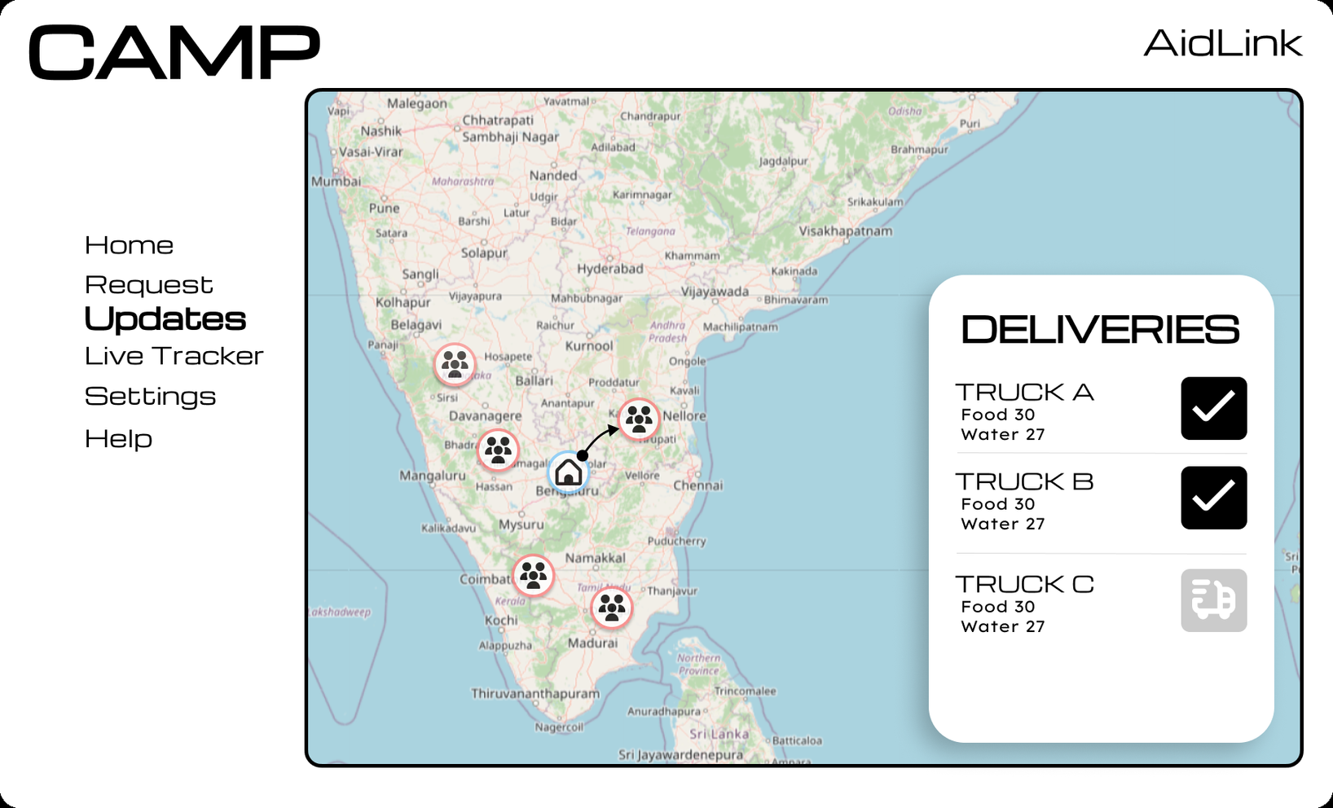

Slide 10
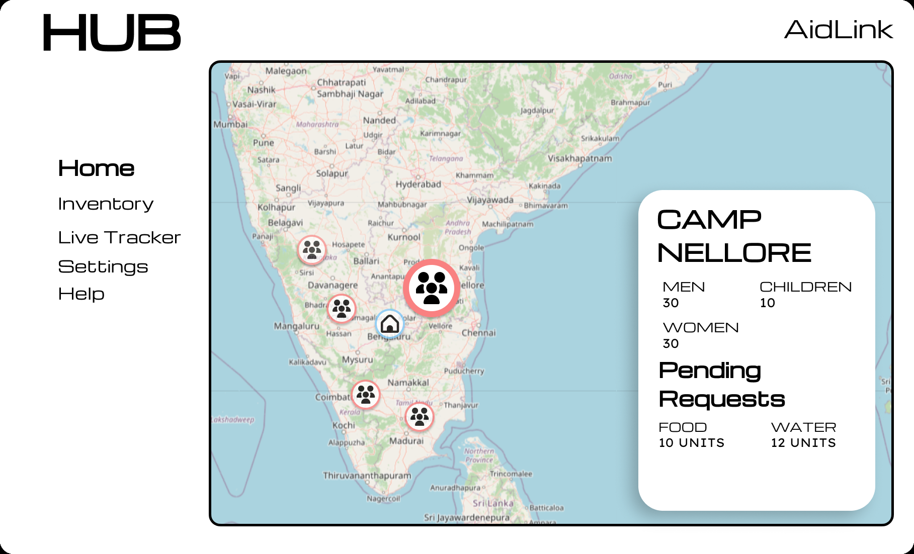

Slide 11
Market Need & Business Potential
AI for Energy Efficiency and Environmental Protection
02
03
04
01
03
High demand in disaster-prone regions
Potential partnerships with logistics and humanitarian organizations
Revenue model : Government contracts, NGO partnerships, and CSR funding.
Governments & NGOs require efficient disaster response tools

Slide 12
01
Blockchain integration for secure relief distribution records
Future Scope
AI-powered predictive analytics for demand forecasting
02
Expandable in future
Drone and autonomous vehicle delivery for remote areas
03
Crowdsourced disaster reporting for real-time updates
04

